Slide 1
SENTIMENT ANALYSIS ON IMAGE AND TEXT
DEPARTMENT OF AI & DS
Hemanth Jasti

Slide 2
First Review
Abstract
Introduction
Technology and Domain
Front End and Back End Details
Literature Survey
Objectives
Methodology
Dataset
Modules Explanation (Few modules with demo)
Sample Code and Screenshot of output
Conclusions
Reference

Slide 3
ABSTRACT
In this regard, by combining textual comments and image data from social media site, this work presents a novel method for sentiment analysis. Considering the multimodal character of user expression, our goal is to create a comprehensive framework that will integrates natural language processing.
Techniques for textual content and computer vision techniques for image analysis to provide a more understanding of sentiment in online interactions.Additionally, we delve into the emerging field of image sentiment analysis, discussing convolutional neural networks (CNNs) and transfer learning approaches to decode sentiments from images.
Through real-world examples and case studies, we highlight the applications of sentiment analysis across domains such real life analysis.
By the end of this presentation, attendees will gain a comprehensive understanding of sentiment analysis and their practical implications in harnessing the power of sentiment in textual and visual content.

Slide 4
introduction
Technology :
HTML:
A document-formatting language derived from the Standard Generalized Markup Language (SGML), predominately used to create Web pages.
The user’s browser interprets HTML commands and formats the page layout, fonts and graphics on the screen
CSS:
CSS is a computer language for laying out and structuring web pages (HTML or XML).
This language contains coding elements and is composed of these “cascading style sheets” which are equally called CSS files.
Java script:
JavaScript is a scripting language that enables you to create dynamically updating content, control multimedia, animate images, and pretty much everything else.

Slide 5
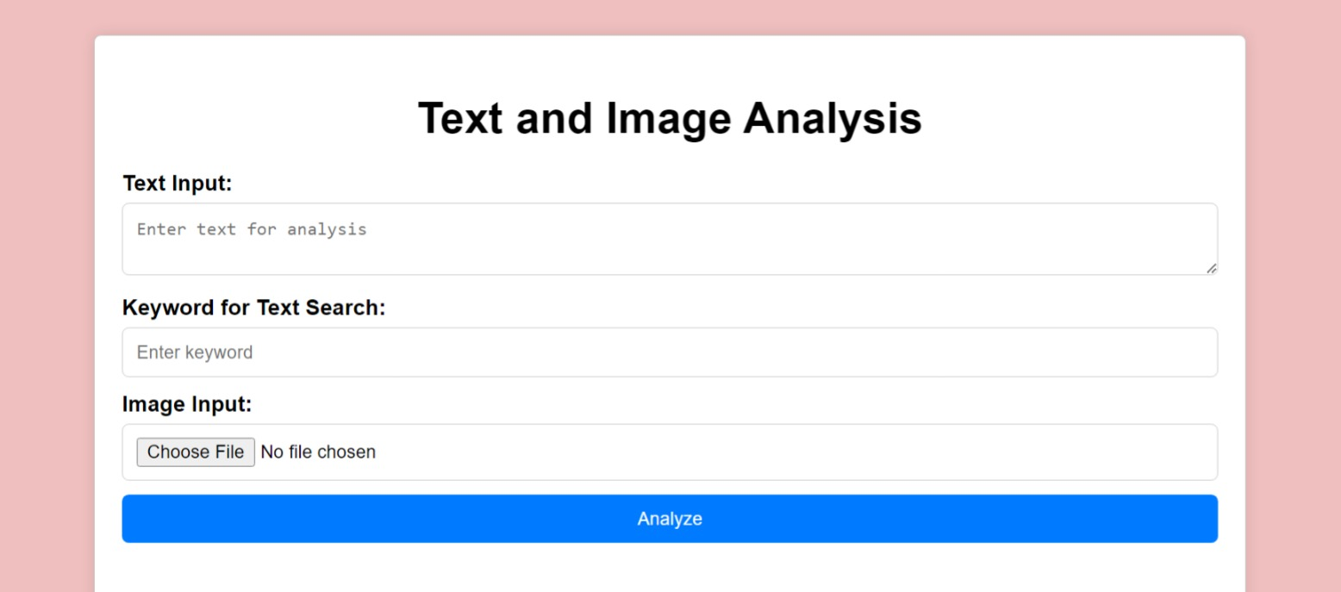
Domain
Web application:
a web application is a piece of software that runs on a web server
It reflects the cognitive computing aspect of your system and implies the generation of insights through AI-powered analysis.
The front-end of the project is designed user-friendly for the user to use and sentimental analysis is performed and displayed to the users. The back-end of the model is Programmed using python.

Slide 6
Literature survey
"Recent Trends in Deep Learning Based Sentiment Analysis" by Lei Zhang et al. (2021): This survey paper provides an overview of recent advancements in deep learning techniques for sentiment analysis, including both text and image modalities. It covers topics such as transfer learning, pre-trained language models, and multimodal fusion for improved sentiment analysis performance.
"Deep Learning for Image Sentiment Analysis: A Survey" by Jianming Sun et al. (2020): This survey paper provides insights into recent developments in deep learning techniques for image sentiment analysis. It covers topics such as deep convolutional neural networks (CNNs), attention mechanisms, and transfer learning for analyzing sentiment in images.

Slide 7
Literature survey (cont…)
"A Comprehensive Survey on Sentiment Analysis: Recent Advances and New Directions" by Xiaonan Wang et al. (2021): This comprehensive survey covers recent advances in sentiment analysis techniques, methodologies, and applications. It discusses emerging trends such as aspect-based sentiment analysis, sentiment intensity prediction, and sentiment reasoning.
"Recent Advances in Multimodal Sentiment Analysis: A Comprehensive Review" by Hieu Pham et al. (2020): Focusing on multimodal sentiment analysis, this review paper discusses recent advancements in integrating text and image modalities for sentiment analysis. It covers fusion techniques, benchmark datasets, and challenges in multimodal sentiment analysis.

Slide 8
objectives
Explore Ethical and Privacy Considerations: Address ethical and privacy considerations associated with sentiment analysis, particularly concerning user-generated content and sensitive information.
Develop a Unified Sentiment Analysis System: The primary objective is to design and implement a cognitive system that can analyze sentiment from both text and image data.
This system will leverage state-of-the-art machine learning and deep learning algorithms to extract and classify sentiment expressed in unstructured multimedia content.
In order to provide a more comprehensive knowledge of user sentiments in the dynamic and complicated world of social media, the goal is to improve the accuracy and depth of sentiment classification. In order to improve decision-making processes in the context of online interactions, the project also intends to investigate real-world applications of the suggested framework in areas including sentiment-aware marketing tactics, content recommendation, and brand perception analysis.

Slide 9
Methodology
Data Collection
Pre-processing
Feature Extraction
Model Development
Training and Evaluation
Optimization
Deployment and application
Continuous Improvement

Slide 10
Dataset
Text dataset from Kaggle
Google images
Image dataset from git-hub

Slide 11
MoDULEs Explanation
1. Natural language processing:
Natural Language Processing (NLP) Text Sentiment Analysis is a branch of artificial intelligence
It involves using algorithms to determine the emotional tone in textual content.
By analyzing language patterns, sentiment-laden words, and context, NLP models classify text as positive, negative, or neutral.
Widely applied in social media monitoring and customer feedback analysis, sentiment analysis provides insights into public opinion and brand perception.

Slide 12
MoDULEs Explanation(cont…)
2. Deep learning :
Deep learning image sentiment analysis employs Convolutional Neural Networks (CNNs) to automatically decipher emotions in images.
Trained on labeled datasets, these models learn to recognize sentiments like happiness or sadness.
Transfer learning may be utilized for enhanced performance. After training, the model can assess sentiments in new images, offering valuable applications in social media analysis, market research, and content moderation.

Slide 13
CONCLUSION
The cognitive system for sentiment analysis of unstructured data represents a significant advancement in extracting valuable insights from multimedia content.
By harnessing the synergies between text and image modalities, organizations can gain a comprehensive understanding of sentiment dynamics, driving informed decision-making, and fostering innovation and growth in today's data-driven landscape.
By integrating text and image sentiment analysis modules, the cognitive system provides a more holistic understanding of sentiment expressed in diverse multimedia content.
The cognitive system empowers organizations with actionable insights derived from sentiment analysis, enabling informed decision-making and strategic planning. By leveraging sentiment analysis across multiple modalities, organizations can identify emerging trends, assess customer satisfaction, and tailor products and services to meet evolving demands.

Slide 14
references
Gaurav Meena*, Krishna Kumar Mohbey, Ajay Indian, Sunil Kumar, Sentiment Analysis from Images using VGG19 based Transfer Learning Approach ,2022
Kinjarapu Rajasekhar, Sentimental Analysis on Instagram Using Machine Learning Techniques,2022
Xingwang Xiao, Yuanyuan Pu, Zhengpeng Zhao, Rencan Nie, Dan Xu, Wenhua Qian & Hao Wu Image–Text Sentiment Analysis Via Context Guided Adaptive Fine-Tuning Transformer, 2023
Ringki Das, Thoudam Doren Singh Multimodal Sentiment Analysis: A Survey of Methods, Trends, and Challenges , 2023

Slide 15
Thank you

